Slide 1
SOCIAL MEDIA MARKETING
ROLL NO: 23BS(AI)036
Computer fundamental

Slide 2
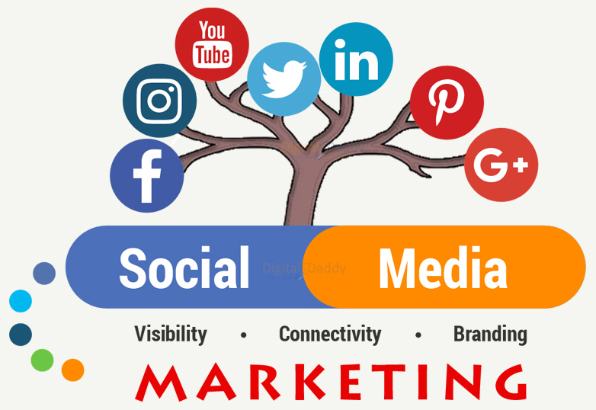
WHAT IS SOICAL MEDIA MARKETING? The social media marketing (also known as digital marketing ) is the use of social media the platforms on which users build social networks and share information about brand . To build company’s brand, increase sales ,and drive website traffic.

Slide 3

Steps: Specific platform two type of platform. 1:engagement 2:SEO ”Search engine optimization” principle platform focus on one platform

Slide 4


optimization
1:primary keyword 2:secondary keyword
Content creation
1.Core Product
product
Service
Testimonial
2.Engaging content
Emotional
Funny
shareable

Slide 5
TRAFIC
BRANDING
QUALITY
PRICE
TIME
BUILD TRUST
IMPROVE YOUR BRAND
IMPORTANCE OF SOICAL MEDIA MAEKETING

Slide 6


content posting
timing
pattern
automation
ending
call to acton

Slide 7
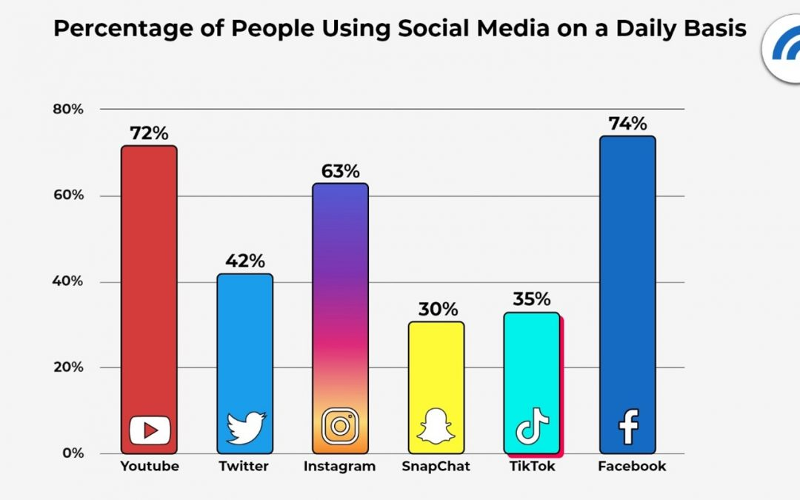

Slide 8
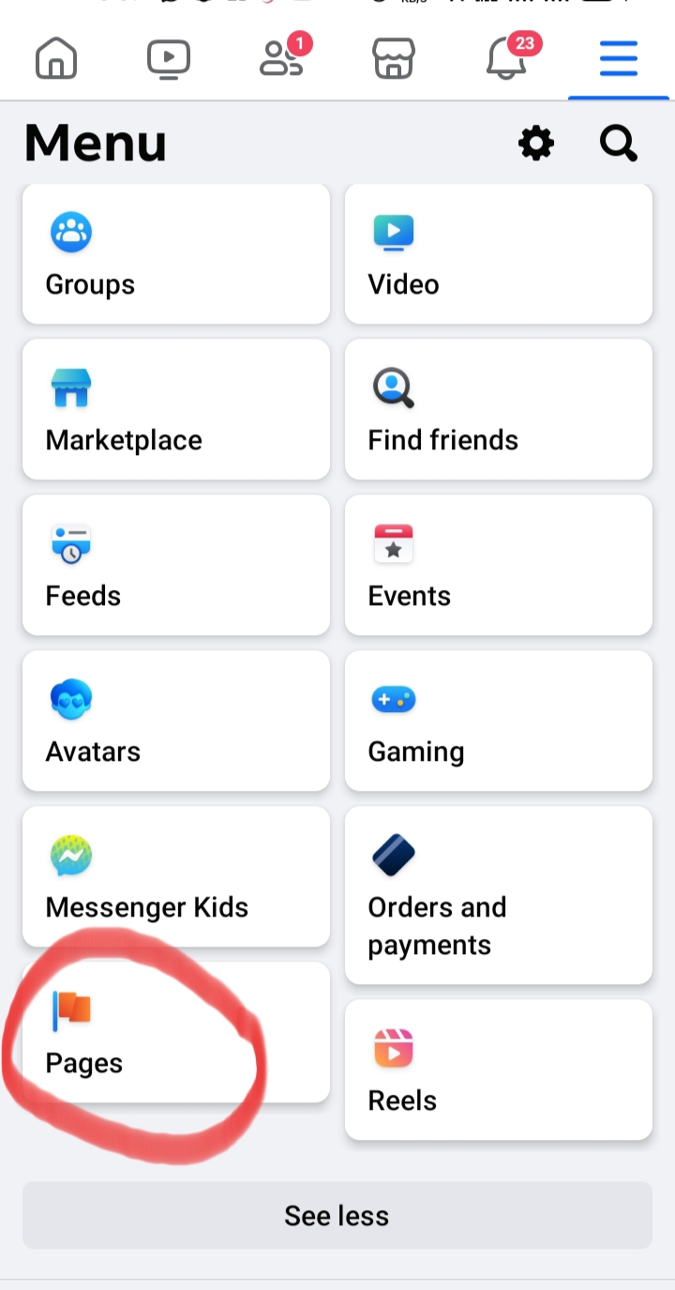

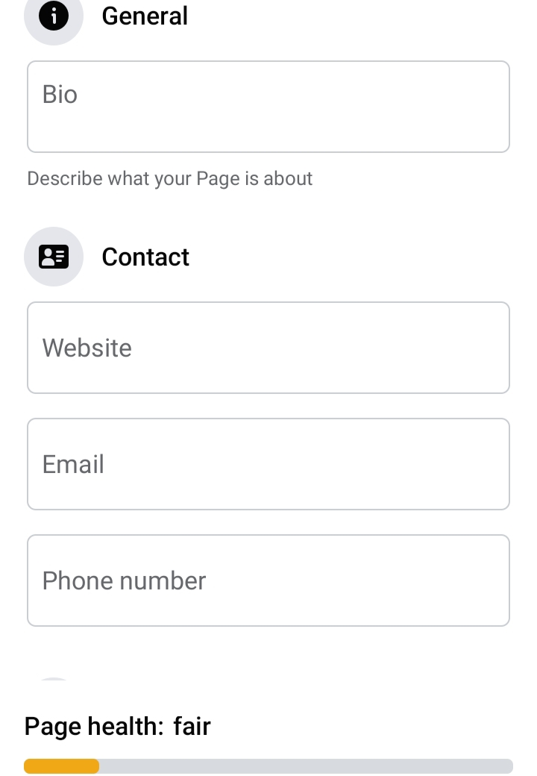
HOW TO CREAT A PAGE ON FACEBOOK?
step 1:
step 2:
step 3:

Slide 9
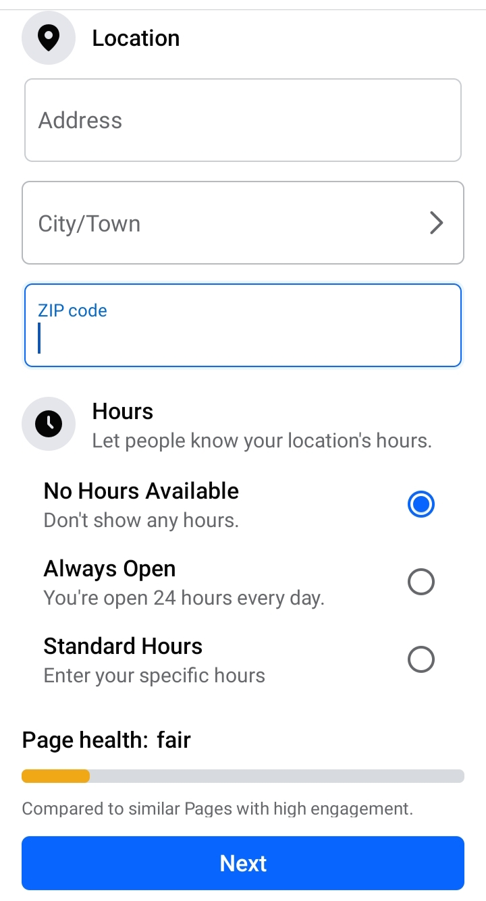

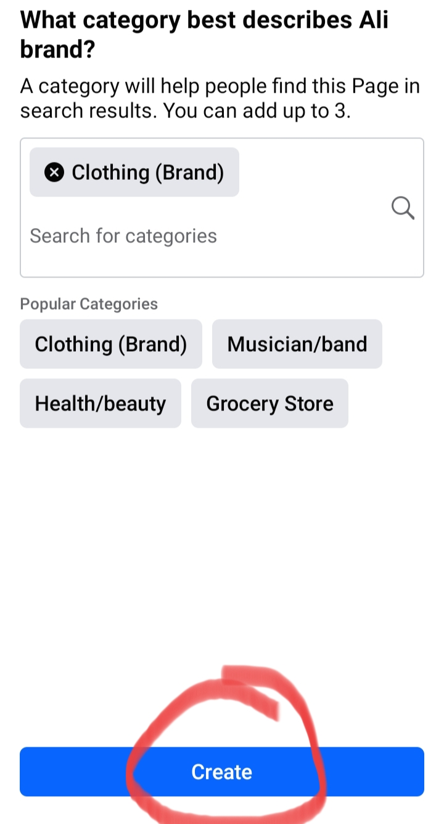
step 4:
step 5:
step 6:

Slide 10
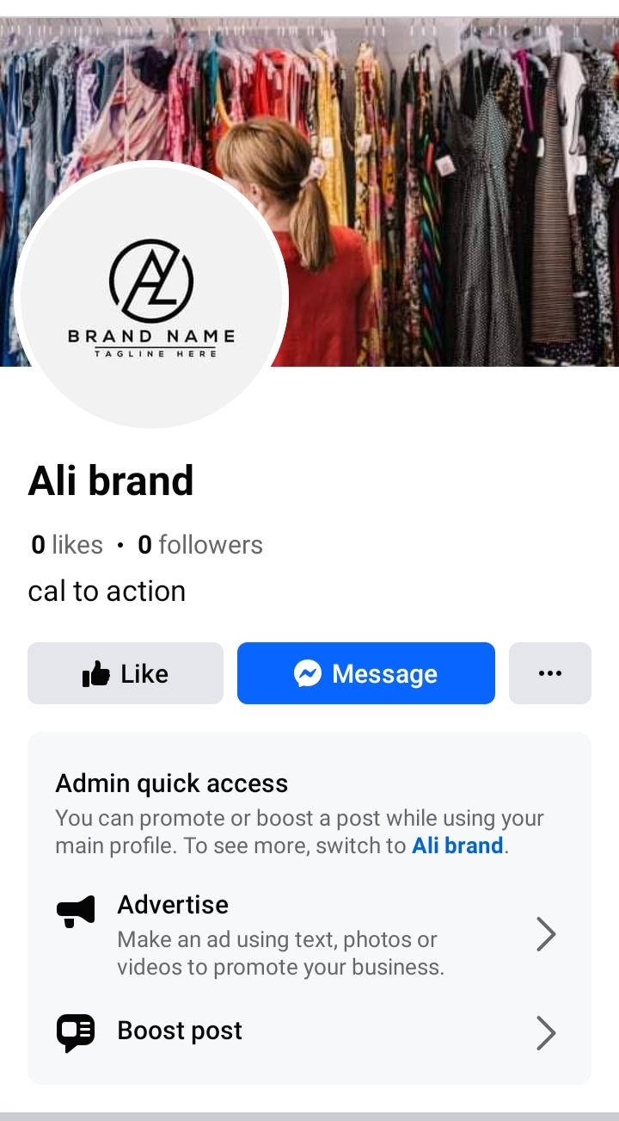
step 7:
THANK YOU

